Slide 1











Agentic data product curation
REFERENCE ARCHITECTURE
From user intent to a published data product
USER & WORKSPACE
CONTEXT SOURCES
Harness
OpenAI Agents SDK · [Model]
Curator
Ontology
States intent in chat; attaches docs, PDFs, specs
Business concepts
MetaQ
Workspace UI
Main agent
Reviewer agent
Metadata layer
Plans, gathers context, drafts the mapping
loop
Validates, scores, returns issues to revise
Chat
Converse, steer, approve
Denodo MCP
Profiling & sampling
Canvas · AG Grid
HARNESS CAPABILITIES
Intent ↔ source mapping, updated live
Subagents
Context compaction
File-system offload
Skills
Source code search
MCP client
Multi-format ingestion
Canvas sync
Logic, joins, usage
Previous mappings
Reusable patterns
GOVERNANCE
Validated mapping
Human review & edits
Approve
Publish to [Data Catalogue]
Notes:
The curator states the data product intent in chat and attaches any supporting context: docs, PDFs, specs. The harness, built on the OpenAI Agents SDK, runs a main agent that plans the work and queries five context sources: the ontology for business concepts, MetaQ for metadata, Denodo MCP for profiling and sampling, source code search for transformation logic, and previous mappings from approved data products so proven patterns are reused. Harness capabilities include subagents the main agent can spin up when needed, context compaction, file-system offload, skills, an MCP client, multi-format ingestion and canvas sync. It drafts the intent-to-source mapping, which appears live in the AG Grid canvas. A reviewer agent validates it and sends issues back until it passes. Humans then review, edit and approve before the data product is published to the catalogue.

Slide 2
From manual to agent-assisted curation
PROCESS FLOW
Humans decide · the agent does the legwork
Today · manual
Sequential hand-offs across analysts, stewards and engineers
Impact
01
02
03
04
05
06
Manual → agent-assisted
Capture request
Search metadata
Map to ontology
Profile data
Read source code
Spec, review & publish
Data engineer
Cycle time (days)
Analyst
Data steward
Data steward
Data engineer
Steward + owner
[__] → [__]
Knowledge sits with people · gaps surface late and force rework · [__ weeks] per data product
Effort (hours)
With the harness · agent-assisted
Agent works the sources in parallel; you steer and approve
[__] → [__]
01 · You
02 · Agent
03 · Agent
04 · Agent
05 · You
06 · Agent
First-pass accuracy
Describe intent
Gather context
Draft mapping
Validate
Review & approve
Publish
[__%]
Main agent queries 5 sources
Live on AG Grid canvas
Reviewer agent checks
To [Data Catalogue]
Chat + docs, PDFs
Edit cells, accept, reject
Products / quarter
[__] → [__]
↺ Reviewer findings and your edits loop back until you approve
Human-in-the-loop checkpoint
Agent step
Notes:
Today, curating a data product is a chain of hand-offs. An analyst captures the request, data stewards search metadata and map it to the ontology, engineers profile the data and read source code, and then the team writes the spec, reviews it and publishes. Knowledge sits with individuals, and gaps often surface late, which forces rework. With the harness, the user describes the intent once, with supporting documents. The main agent gathers context from all five sources, spawning subagents when needed, including previous mappings from approved products, drafts the mapping live on the AG Grid canvas, and a reviewer agent validates it. The user then reviews, edits cells, and accepts or rejects. Reviewer findings and human edits loop back to the agent until the user approves, and only then is the product published to the catalogue. Fill in the impact metrics on the right with your baseline and pilot numbers.

Slide 3


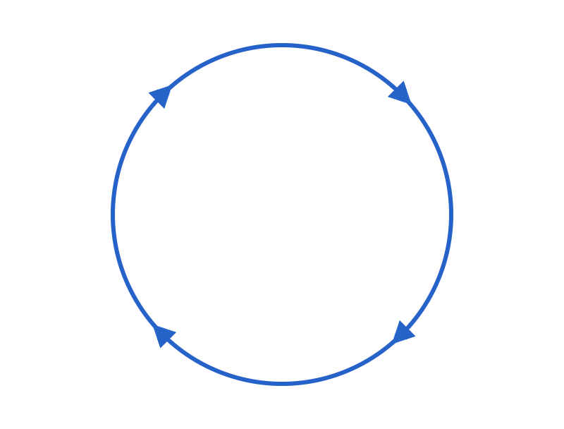



Layered runtime view
REFERENCE ARCHITECTURE · ALTERNATIVE VIEW
Control / tool calls
Context & results
1–6
Human feedback loop
Request path, in order
EXPERIENCE
1
Chat
3
Canvas · AG Grid
Where users work
Curator states intent, attaches docs, steers
Draft mapping shown live
Plan
2
4
Main agent
Reviewer agent
CONTROL PLANE
Gathers context, drafts
Validates, scores, flags
Agent state
Harness
Agent loop
Working context
Offloaded files
Session history
Canvas state
OpenAI Agents SDK
Review
Act
HARNESS CAPABILITIES
[Model]
Subagents
Skills
MCP client
Context compaction
Observe
File-system offload
CONTEXT PLANE
Ontology
MetaQ
Denodo MCP
Code search
Prior mappings
MCP & tools
Business concepts
Metadata layer
Data profiling
Logic & lineage
Reusable patterns
GOVERNANCE
Validated mapping
5
Human review & edit
Approve
6
Publish to [Catalogue]
Human approval
Notes:
This is an alternative to the first architecture slide; keep whichever reads better for your audience. Follow the blue numbers 1 to 6, each used once, to trace one request. 1: the curator states the intent in chat, with any documents. 2: the main agent plans, gathers context from the context plane through MCP and tools (ontology, MetaQ, Denodo MCP, code search, prior mappings) and drafts the mapping. Subagents are one of the harness capabilities, alongside skills, MCP, context compaction and file-system offload; the main agent uses them when the task needs it. 3: the draft mapping appears live on the AG Grid canvas. 4: the reviewer agent validates it; the loop of plan, act, observe and review repeats until it passes. 5: the human reviews and edits on the canvas, then approves. 6: the data product is published to the catalogue. The orange dashed line on the left shows human edits and rejections going back to the main agent. Agent state covers working context, offloaded files, session history and canvas state.

Slide 4
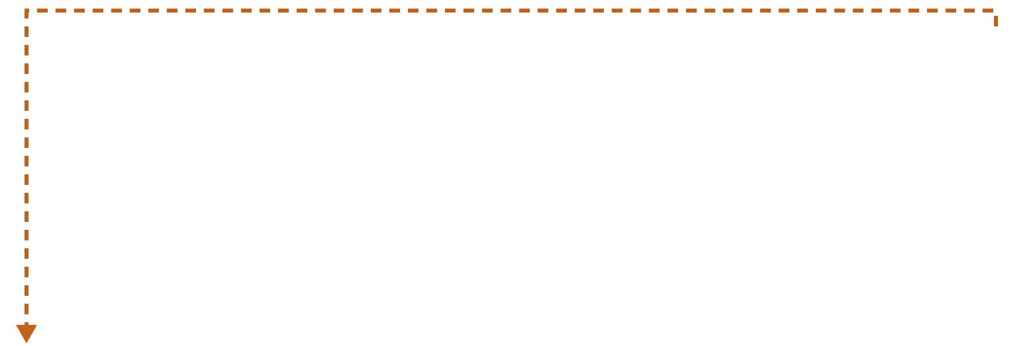
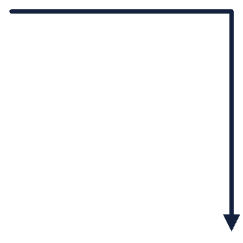
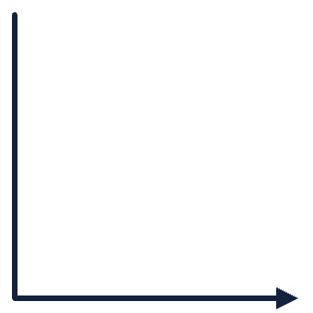
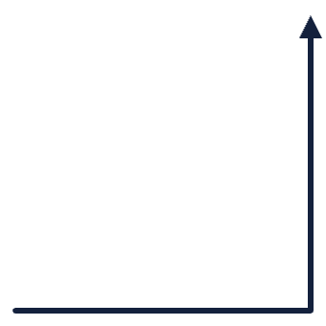
How a data product gets curated
REFERENCE ARCHITECTURE · RUNTIME FLOW
Flow
Rework loop
Context lookup
1 · You
↺ Changes requested
3 · Canvas
5 · You
YOU
Start
Draft ready
Approve
Chat & canvas
Intent + docs
in chat
Mapping
in AG Grid
Review, edit,
sign off
2 · Main agent
4 · Reviewer
6 · Harness
Maps intent
Validates
Publish
HARNESS
Queries the
sources
Flags issues
to fix
To [Data
Catalogue]
Agents
↺ Issues → main agent re-edits the canvas
CONTEXT
Ontology
MetaQ
Denodo MCP
Code search
Prior mappings
The main agent pulls only what it needs
MCP & tools
HARNESS CAPABILITIES
Subagents
Skills
MCP client
Context compaction
File-system offload
OpenAI Agents SDK · [Model]
Notes:
Follow the arrows left to right; the flow zig-zags between you and the agents. 1: you start in chat with your intent and any documents. 2: the main agent maps the intent, querying only the context sources it needs: ontology, MetaQ, Denodo MCP, code search and prior mappings. 3: the draft mapping appears on the AG Grid canvas. 4: the reviewer agent validates it; if it finds issues, the main agent re-edits the canvas and the reviewer checks again. 5: you review, edit if needed and approve; if you request changes, it goes back to the main agent. 6: after your approval, the harness publishes the data product to the catalogue. Subagents, skills, MCP, context compaction and file-system offload are harness capabilities the main agent uses as needed, not fixed steps.

Slide 5

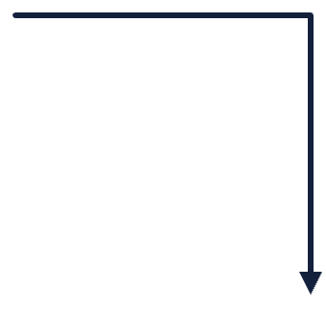





Architecture in motion
REFERENCE ARCHITECTURE · PLANES + RUNTIME FLOW
Flow
Rework loop
Context lookup
1 · You
↺ Changes requested
3 · Canvas
5 · You
EXPERIENCE
Start
Draft ready
Approve
Chat & canvas
Intent + docs
in chat
Mapping
in AG Grid
Review, edit,
sign off
2 · Main agent
4 · Reviewer
CAPABILITIES
CONTROL
Maps intent
Validates
Subagents · Skills · MCP
Harness
Queries the
sources
Flags issues
to fix
Compaction · FS offload
Agents SDK
Used as needed
[Model]
↺ Issues → main agent re-edits the canvas
CONTEXT
Ontology
MetaQ
Denodo MCP
Code search
Prior mappings
MCP & tools
6 · Harness
GOVERNANCE
Nothing is published without your approval on the canvas
Publish
Approval gate
[Data Catalogue]
Notes:
This slide combines the layered architecture and the runtime flow. The four bands are the architecture planes: experience, control, context and governance. The path shows how one request moves through them, zig-zagging between you and the agents. 1: you start in chat with your intent and documents. 2: the main agent maps the intent, querying only the context sources it needs. 3: the draft mapping appears on the AG Grid canvas. 4: the reviewer agent validates it; if it finds issues, the main agent re-edits the canvas. 5: you review, edit and approve on the canvas; if you request changes, it goes back to the main agent. 6: only after approval does the harness publish the data product to the catalogue. Subagents, skills, MCP, context compaction and file-system offload are harness capabilities the main agent uses as needed.

